Slide 1
Linux Kernel Development 04
工海系 b06501018 朱紹勳

Slide 2
 | Linux Kernel Dev 3rd | Understand Linux Kernel 3rd
Bootstrap |  | System Bootstrap | Linux system management handbook
Interprocess Communication |  | Chapter 19 | Advance Programming in Unix Enivronment
Timing | Chapter 11 | Chapter 6
Memory Addressing |  | Chapter 2

Slide 3
Bootstrap

Slide 4
Bootstrap
BIOS(Basic Input / Output System)
protected mode / real mode(√)
Procedure
(1) Run a series of tests on hardware. (2) Initializes the hardware devices, start kernel thread & init. (3) Searches OS to boot (access section in CD-ROM) (4) Copy the contents of to RAM, starting from physical address 0x00007c00, (5) Jump to that address and executes code.

Slide 5
Continue…
Read the first 512 bytes of storage → Master Boot Record(MBR)
MBR will tell which partition has the boot loader
Boot loader store OS info, memory address
GNU GRUB:
deal with multiple os in same computer (dual boot selection)
Run shell script
Boot loader will help we load into linux kernel

Slide 6
start_kernel(): (1) sched_init() (2) build_all_zonelists() /* initialize memory zone */ (3) page_alloc_init() and mem_init() /* Buddy system allocators */ (4) trap_init() and init_IRQ /* initialize IDT */ (5) softirq_init() /* initialize TASKLET_SOFTIRQ */ (6) time_init() /* initialize time system*/ (7) kmem_cache_init() /* initial slab (memory management) */ (8) calibrate_delay() /* check CPU clock speed */ (9) process 1 is created by invoking the kernel_thread() /* init */
BIOS → MBR → boot loader → kernel → init process → login
Root File system

Slide 7
Interprocess Communication

Slide 8
Interprocess Communication
Mechanisms
(1) Pipe
(2) Semaphores
(3) Messages
(4) Shared memory regions
(5) Socket

Slide 9
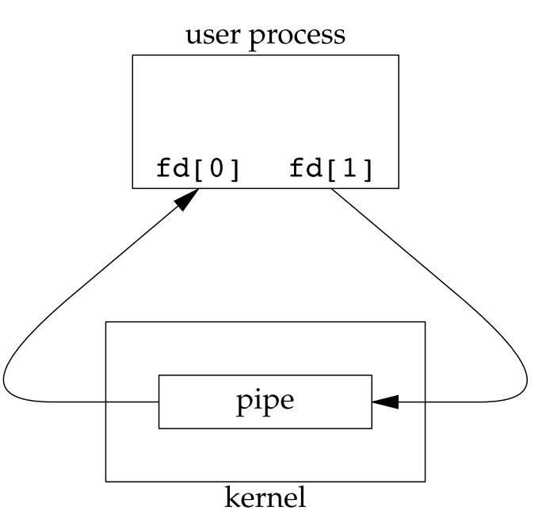
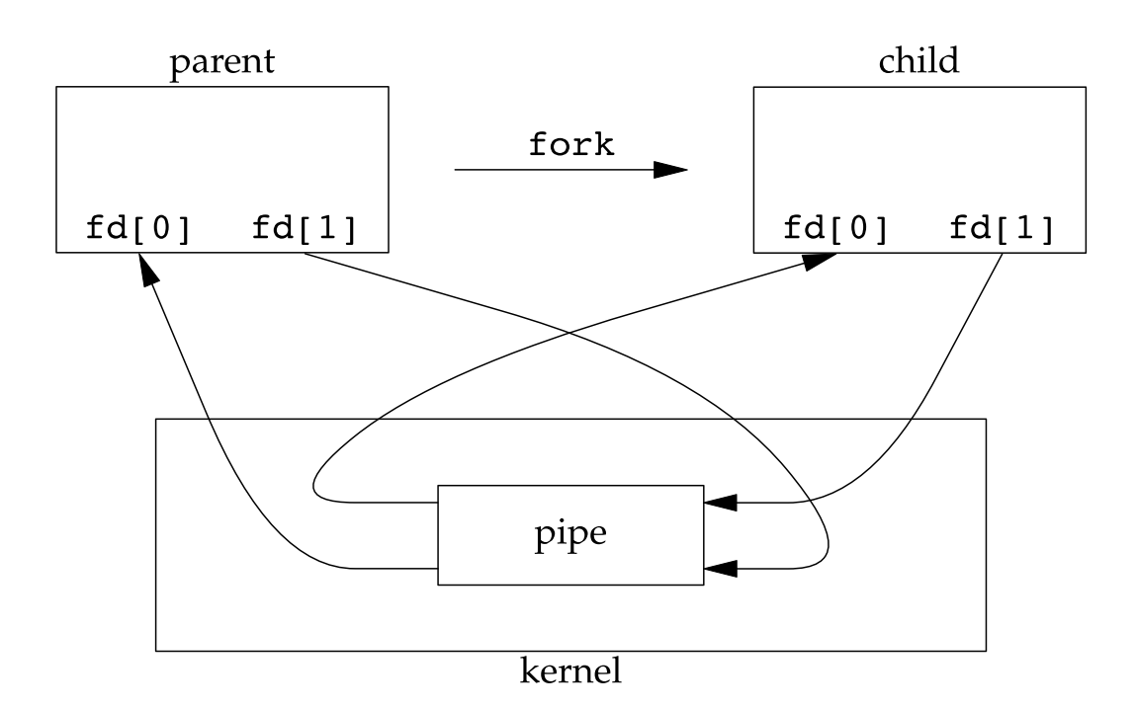
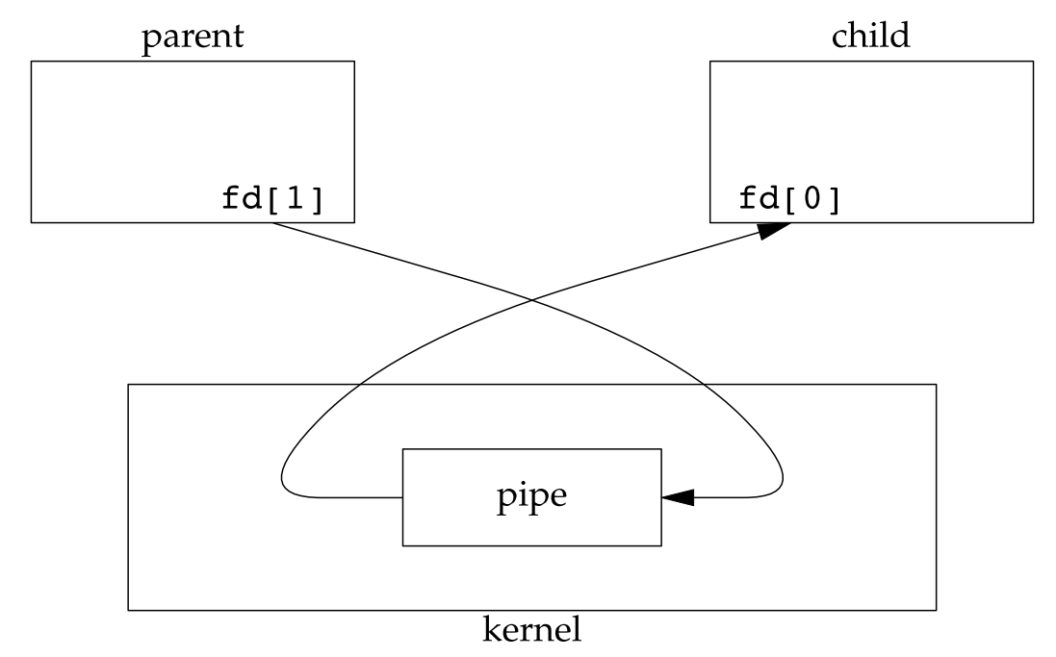
Pipe / FIFO
$ ls | more
one pipe has one direction flow.
pipe(), popen(), pclose()
#include "apue.h"
int main(void){
int n;
int fd[2];
pid_t pid;
char line[MAXLINE];
if (pipe(fd) < 0) err_sys("pipe error");
if ((pid = fork()) < 0) {err_sys("fork error");}
else if (pid > 0) { /* parent */
close(fd[0]);
write(fd[1], "hello world\n", 12);
} else { /* child */
close(fd[1]);
n = read(fd[0], line, MAXLINE);
write(STDOUT_FILENO, line, n);
}
exit(0);
}
#include <stdio.h>
…
FILE *fp;
int status;
char path[PATH_MAX];
if(fp == NULL)
/* Handle error*/
while (fgets(path, PATH_MAX, fp) != NULL)
printf(“%s”, path);
status = pclose(fp);
if (status == -1){
/* Error reported by pclose()*/
}else{
/* Use macros described under wait() to inspect “status” in orderto determine success/failure of command executed by popen() */
}
Notes:
Parent send data to child

Slide 10
System V IPC
Linux system programming support both System V & POSIX
System V is originated from AT&T
Allow User Mode processes:
Synchronize processes by semaphores
send & recv message
Share a memory area

Slide 11
IPC Semaphore
Just like the semaphore mentioned in process chapter, is a counter
semaphore control a shared resource, and limit the process to access
a struct called semid_ds
int semget(key_t key, int nsems, int ﬂag); // create &obtain a semaphore ID
int semctl(int semid, int semnum, int cmd, ... /* union semun arg */ ); // semaphore initialization
int semop(int semid, struct sembuf semoparray[], size_t nops); // Related operation

Slide 12
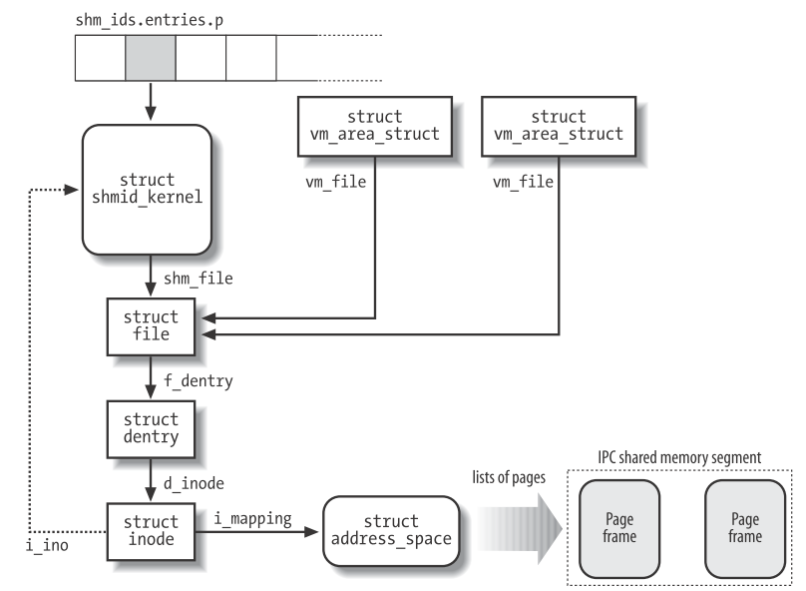
IPC Shared Memory
Mentioned in OS course, the fastest IPC ways
Related to virtual file system
int shmget(key_t key, size_t size, int ﬂag); // obtain a shared memory identiﬁer
int shmctl(int shmid, int cmd, struct shmid_ds *buf ); // various shared memory operations
void *shmat(int shmid, const void *addr, int ﬂag); // process attaches it to its address space
int shmdt(const void *addr); // done with a shared memory segment, we call shmdt to detach it
void *mmap(void *addr, size_t len, int prot, int ﬂag, int fd, off_t off ); // map a context to the memory

Slide 13
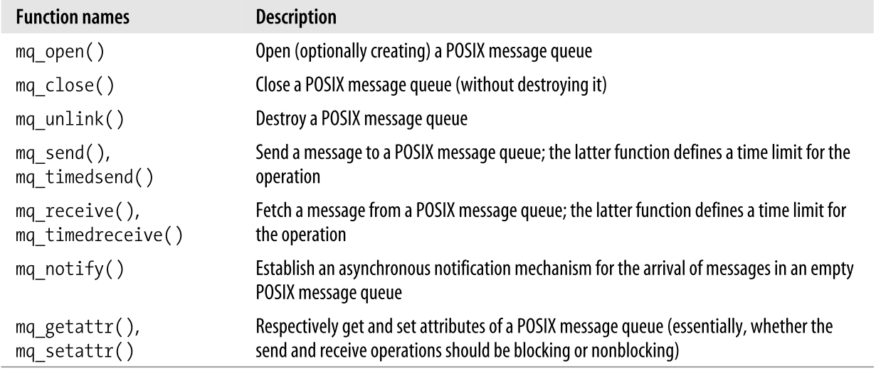
POSIX Message Queue
Message Queue is a linked list store in kernel
POSIX interface seems simpler, better than old System V
Other interface, like XSI

Slide 14
Timer & Time Management

Slide 15
Purpose of timer:
interrupt, time slice
update run time & real time
Resource statistic
Clock type:
Real Time Clock (always powered) : initialize xtime
System Timer - Programmable Interval Timer (PIT) : interrupt mechanism
tick & HZ:
different default value in architecture, but programmable in <asm/param.h>.
1000 HZ may be a good option

Slide 16
jiffies
A counter variable, recording the total tick after starting. 0xfffb6c20
defined in <linux/jiffies.h>
overflow… #define time_after, time_before, time_after_eq, timer_before_eq
Application:
converts from jiffies to seconds:
(jiffies / HZ)
unsigned long timeout = jiffies + 5*HZ; /*time out in five seconds */
if (time_before(jiffies, timeout)) { /* not yet timeout */
}else{
/* timeout */
}
Notes:
頭五分鐘處於overflow狀態，檢查kernel是否有檢測出錯誤

Slide 17
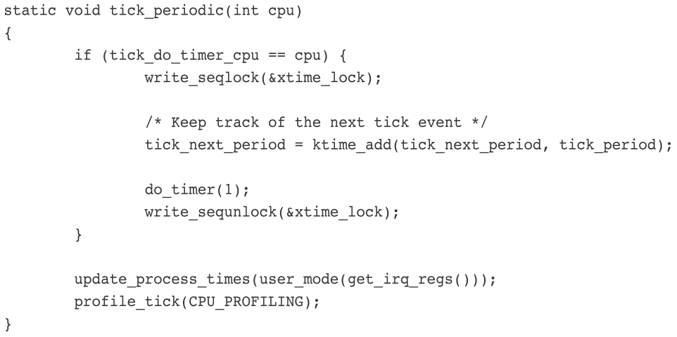
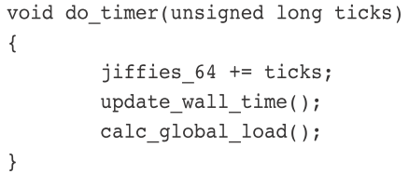
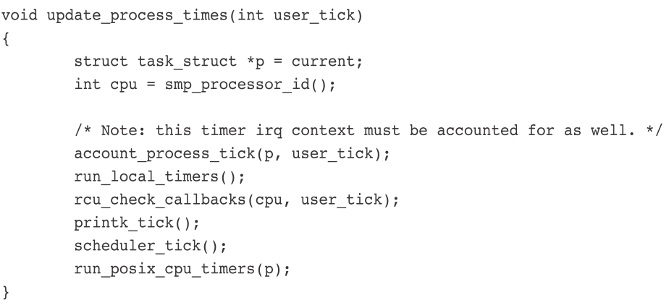
Timer Interrupt : Every 1/1000 sec
Related to architecture
xtime_lock, response & set sys clock, update real time clock, tick_periodic()
Not related to architecture
resource statistic, scheduler_tick()…

Slide 18
Real Time
<time/timekeeping.h>
xtime, 1970/1/1
need seqlock for r&w
read_seqbegin() read_seqretry()
update_times()
---user mode---
gettimeofday()
do_gettimeofday() – sys
settimeofday()

Slide 19
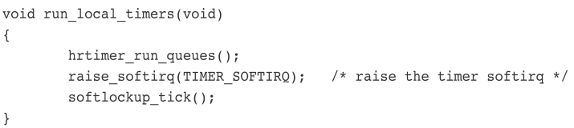
Timer (dynamic, kernel)
defined in <linux/timer.h>, manage kernel time, struct timer_list
executes timers in bottom-half context
Application:
struct timer_list my_timer;
init_timer(&my_timer);
my_timer.expires = jiffies + delay; /* timer expires in delay ticks */
my_timer.data = 0; /* zero is passed to the timer handler */
my_timer.function = my_function; /* function to run when timer expires */
void my_timer_function(unsigned long data);
add_timer(&my_timer);
del_timer(&my_timer);

Slide 20
Delaying Execution
Busy Looping
unsigned long timeout = jiffies + 2*HZ; /* 2 sec */
while (time_before(jiffies, timeout)) cond_resched();
Small Delays
udelay(150); /* delay for 150 μs */
ndelay(2); /* delay for 2 ns */
schedule_timeout()
put task to sleep until delay time has elapsed, then wakeup.
set_current_state(TASK_INTERRUPTIBLE);
schedule_timeout(s * HZ);

Slide 21
Memory Addressing

Slide 22
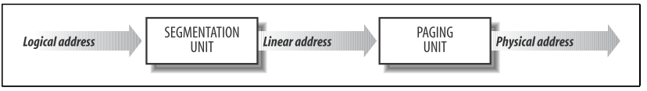
Three types of memory address
(1) Logical Address
used in machine code, segment + offset
(2) Linear(Virtual) Address
32 bits (4GB) 0x00000000 – 0xffffffff
PAE : 36bits
64bit : 128TB…
(3) Physical Address
RAM address
Memory Translation Mode
(1) Real Mode (2) Protected Mode

Slide 23
CPU Mode
(1) Real Mode : Addresses in real mode always correspond to real locations in memory In 8086 arch, people think 1MB RAM is large
(2) Protected Mode allows system software to use features such as virtual memory, paging and safe multi-tasking
(3) Virtual -8086 Mode
(4) System Management Mode

Slide 24
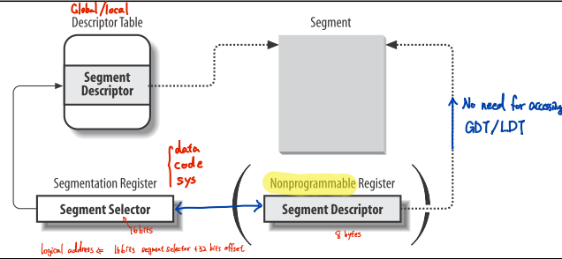
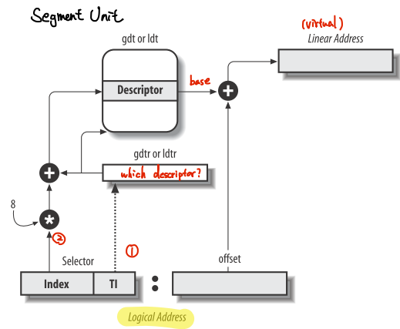
Hardware Segmentation

Slide 25
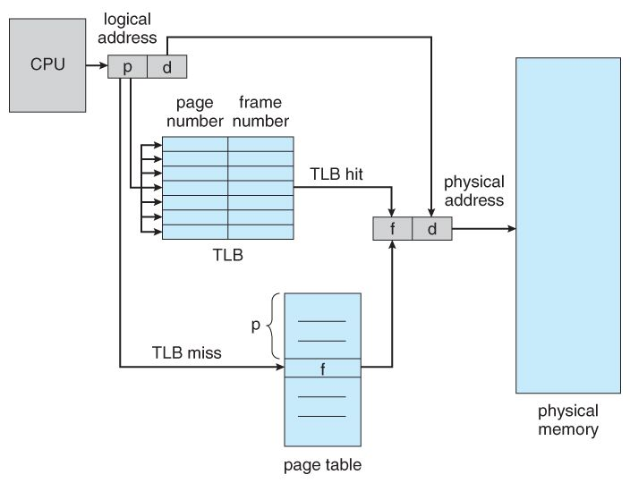
Hardware Paging
Map virtual mem (page) to physical mem (page frame) Fail : Page Fault Exception
For 32 bit : Directory(10) + Offset(22, 4MB) Physical address Extension
For 64 bit : use 3 – 4 level paging
CPU clock (3GHz) vs RAM (2666MHz) : cache(s)
Translation Lookaside Buffer (TLB)
Speedup the translation of virtual mem
Store physical mem in TLB after first time access
Each CPU has its own TLB

Slide 26
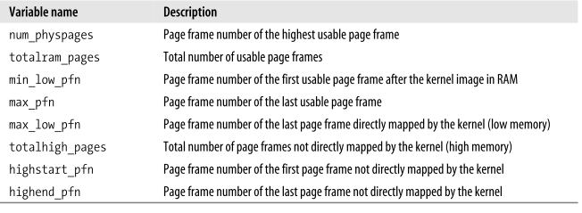
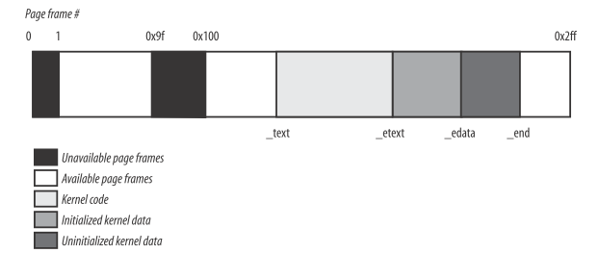
Linux Paging
Adapt 4 level Paging (ver2.6) : global, upper, middle, table
defined Macros for page table handling
Page frame in physical memory :
Every process has individual physical memory section
Page frame 0 is used for BIOS (0x000a0000 ~ 0x000fffff)
Linux kernel store start from 0x00100000(2nd RAM)

Slide 27
Process Page Table
Kernel Page Table
Process virtual memory
0x00000000 – 0xbfffffff addressing in user & kernel mode
0xc0000000 – 0xffffffff addressing only in kernel mode
PAGE_OFFSET 0xc0000000
Maintain a page table in Master kernel Page Global Directory
Initialize :
kernel create a limited address space
kernel use remaining space to create page table
Provisional kernel Page Tables
Map virtual to physical (8MB)
When RAM > 4096MB

Slide 28
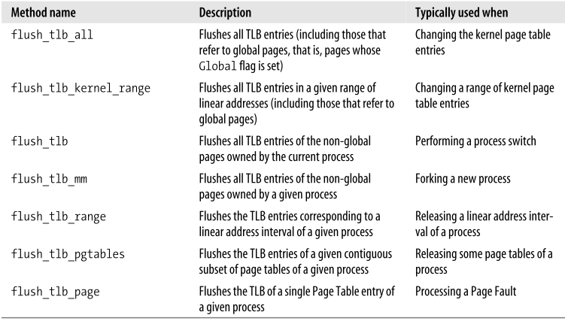
Handling Hardware Cache & TLB
Hardware caches are addressed by cache lines
Mapping of virtual to phys is determined by kernel, not hardware
The timing of flushing TLB
ex: context switch ex: LRU…
For mult-processor, we use interprocessor interrupt to execute TLB-invalidating function
Lazy – TLB the CPU remembers that its current process is running on a set of page tables whose TLB entries for the User Mode addresses are invalid.
TLB-invalidating methods of linux
Intel provide easier method

